Slide 1
Looking forward towards projects
What makes a good DL class project? (Think!)

Slide 2
The papers you read / we teach
Experiments with huge datasets (imagenet is tiny)
Competitions on popular datasets
Theories on “why deep learning works”
New general purpose architectures
Projects that start from zero
… And everything on the list would be horrible class projects (oops)

Slide 3
Let us talk about the data space where DL class projects work
DL usually requires relatively large amounts of data (often not competitive on N =100)
You can not train on really large amounts of data
(N >10,000 is *hard* on colab)

Slide 4
You often need to use more
You will almost always start with pre-trained models that others trained on big data - inductive biases

Slide 5
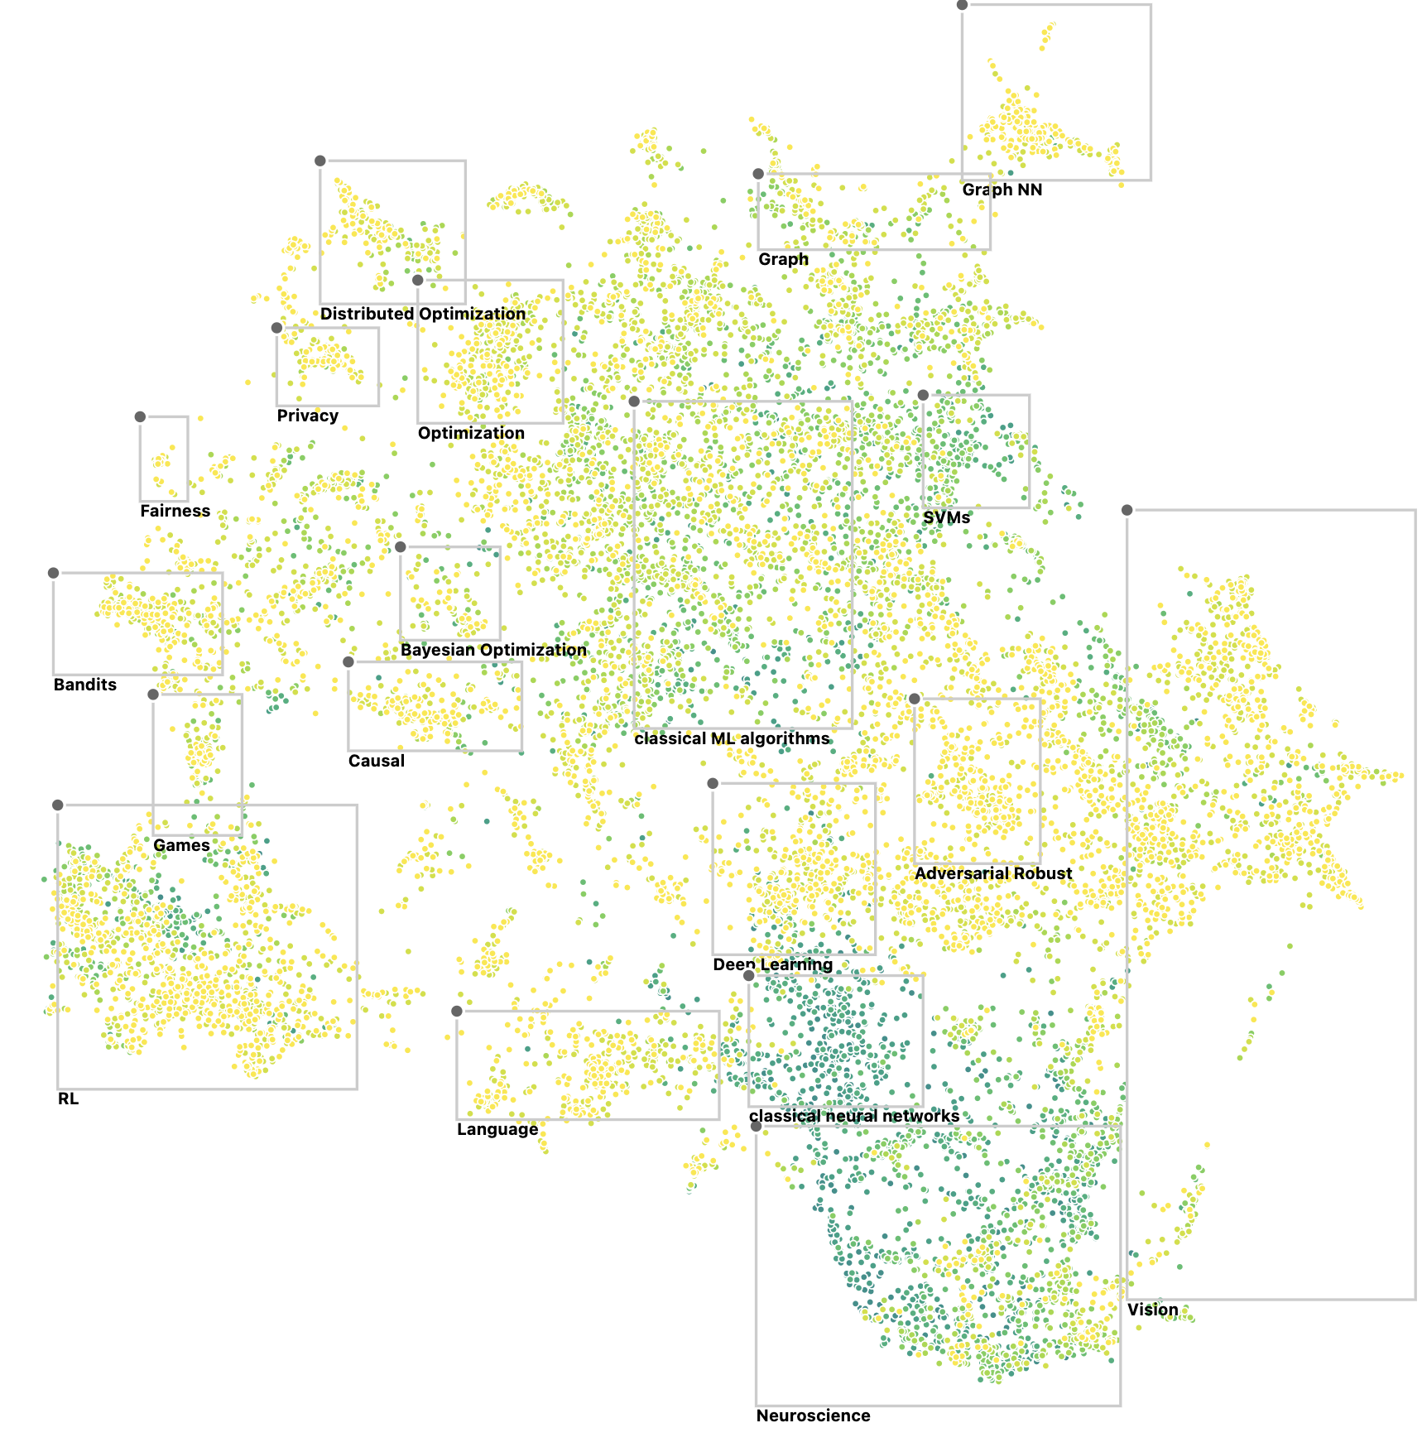
First, you gotta be excited about it!
Where do your interests land in this graph?
(https://60years.vizhub.ai/)

Slide 6
Second you need to have a question
So, what makes for a good question? (Think!)

Slide 7
Criteria for a good question
Must be a question
Must have an answer
Answer must be useful
Answer must come from data
DL must be useful to answer question
You must be able to pull it off
Must not be unethical
Question should not already be answered

Slide 8
Must be a question
We apply convnets to a really large dataset of pictures of alligators
We use GANs and make them bigger

Slide 9
Must have an answer
We will ask how conscious neural networks are
We will ask how learning works in brains

Slide 10
Must be useful
We will ask if Alexnet is better with ReLU or with leaky ReLU
We will distinguish cats from dogs

Slide 11
Answer must come from data
We will analyze what things make people happy
We will analyze why helicopters fly

Slide 12
DL must be useful for the problem
Predict mood based on phone accelerometry K~10 from N~100 students
Decode user intent from brain data from K~200 brain regions from N=80 users
Remark: You will always compare against standard ML

Slide 13
You must be able to pull it off
Data must be small enough
Little enough compute
Not too many steps.
Data must be available. To you.

Slide 14
Must not be unethical
Recognize faces of people that wear a mask
Build a system that automatically writes class project reports
Build a system that finds the right insult for the right person

Slide 15
Novelty
It is a class project.
No need to be really novel.
But, it is very much better if it is.
Rather valiantly fail on a great problem then recook some boring stuff.

Slide 16
What matters for project quality
Find a good question
Show DL skills
Show data thinking

Slide 17
Show DL skills
Do not use complex stuff because it is complex
Simplicity always wins
Still, it is fun to revisit a range of skills you obtained in CIS 522

Slide 18
Show Data skills!
A good data scientists
Understands the domain.
Uses DL to build in knowledge of the domain.

Slide 19
Examples of usable domain knowledge
Electrodes in brains have physics. We know physics is low-d. So lets do preprocessing shared across electrodes.
Music generation. Western music tends to have a tonic key. The patterns of the rhythm section are often conserved. Build both in.

Slide 20
More
Neuron connection probability depends on neuron type. But it also depends on distance. So if I want to learn the type I want distance to be removed.
Modeling hand movement in space is highly stereotypical. So better decoding by having a good model of movements.

Slide 21
DL makes it easy to build in knowledge
Architecture
Cost functions
Data interfaces
Domain adaptation

Slide 22
So in summary
Find a topic you love.
A good question.
In a domain that you understand.
A dataset that you really get.
Good data science = thinking about data.
Shoe Leather approach to data science

